Slide 1
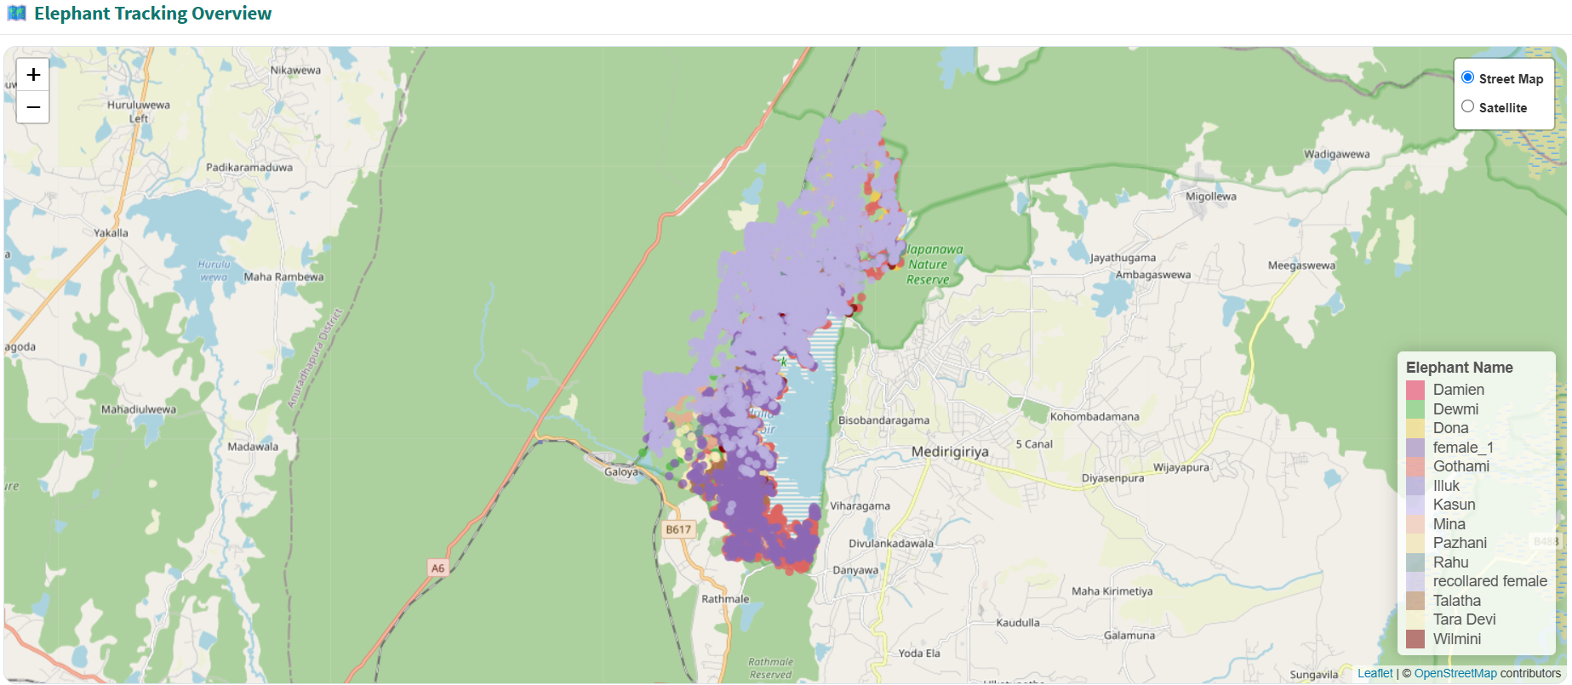
Landscape-Level Movement
All tracked elephants use a common landscape centered around the Kaudulla Reservoir, with many also moving towards the Ralapanawa Nature Reserve.

Slide 2
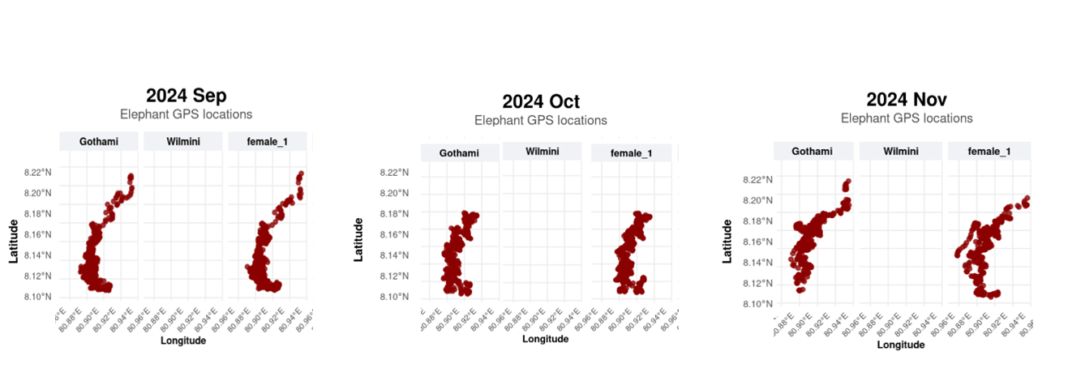
Movement Pattern Observation
An interesting observation is that Gothami and female_1 show very similar movement patterns during September, October, and November 2024.

Slide 3
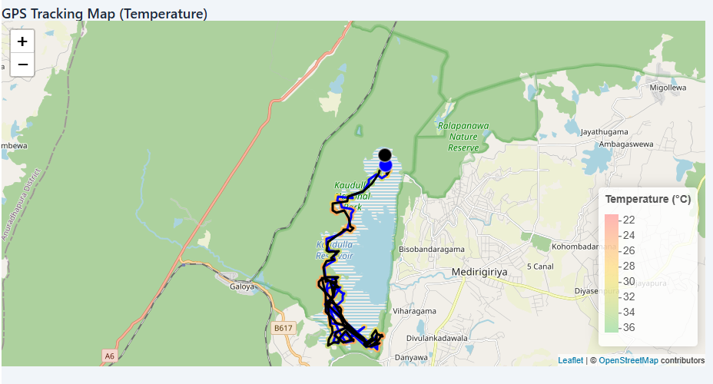

Slide 4
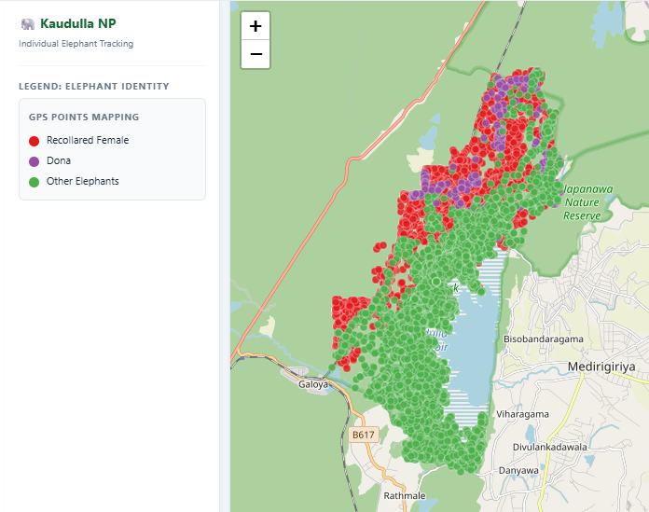
Movement Pattern Observation
Dona mainly stayed in the northern part of the park, while Recollared_Female showed a unique pattern with frequent visits to both the railway track area and the upper region.

